Slide 1



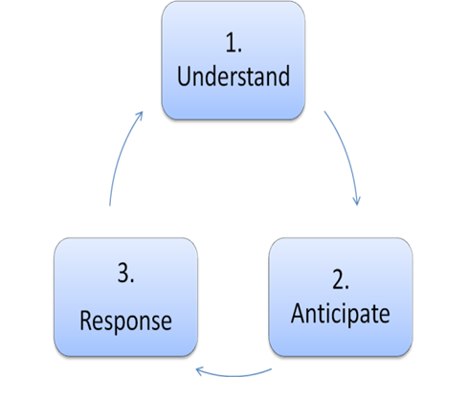










PROACTIVE Newsletter
January 2015
http://www.fp7-proactive.eu
Emergencies, due to man made or natural disasters and terrorism, feature prominently among the threats our society is confronted with. Avoiding an incident and mitigating its potential consequences require developing and deploying new solutions, which exploit the recent advances in terms of technological platforms and problem solving strategies.
The main goal of PROACTIVE is to research a holistic citizen-friendly multi sensor fusion and intelligent reasoning framework enabling the prediction, detection, understanding and efficient response to terrorist interests, goals and courses of actions in an urban environment. To this end, PROACTIVE will rely on the fusion of both static knowledge (i.e. intelligence information) and dynamic information (i.e. data observed from sensors deployed in the urban environment).
The main expected results which will be presented on the Final Proactive Workshop in April include:
Researching a holistic citizen-friendly multi sensor fusion and intelligent reasoning framework enabling the prediction, detection, understanding and efficient response to terrorist interests in urban environment.
Researching and developing a scalable information fusion grid and fusion algorithms that can short-term anticipate and prevent terrorist activities and asymmetric attacks .
Research and developing a fusion grid which shall be autonomic, self-organizing and adaptable to specific urban environments, terrorist profiles and protection goals.
Implementing, Validating and Demonstrating the concept and associated methods, tools and techniques in a controlled (yet realistic) urban environment (which may include simulated components) .
Ensuring the privacy-friendly nature of the PROACTIVE framework creating a privacy certification suite for benchmarking and measuring the privacy friendliness of the framework.
The development of the first version of PROACTIVE prototypes was concluded by the end of the second year of the project. During the project periodic review these prototypes were demonstrated to the PO in June 2014. These prototypes include:
The Terrorist Reasoning Kernel led by CMR
The Ad-Hoc Multi-hop Network with extended QoS features developed by HWC and AGH
The object detection and identification modules developed by SZTAKI
The PROACTIVE database for storing indicators and events of a possible terrorist attack developed by AIT
The PROACTICVE C2 platform developed and optimised by VITRO
The UAV component with extended guidance capabilities developed by UNIBW
The PROACTIVE framework is user-driven, so the research in the project is supported by a rich set of end-users, which are either members of the consortium or members of a special end-user advisory board. Up to February 2015 four End-user Workshops have been organized. The last PROACTIVE End-User Workshop took place on the 16th December 2014 at the VITROCISET premises in Rome, Italy. The Workshop was organized by the Project Coordinator (VITROCISET) with the participation of the consortium partners, the members of the PROACTIVE End-User Advisory Board and additional experts from the following organisations:
Bavarian Criminal Police - Germany
ERANDO Ltd, Security Private End-User from Hungary
Hellenic Police - Greece
Hungarian Public Space Surveillance Council - Hungary
Polish Police - Poland

Slide 2
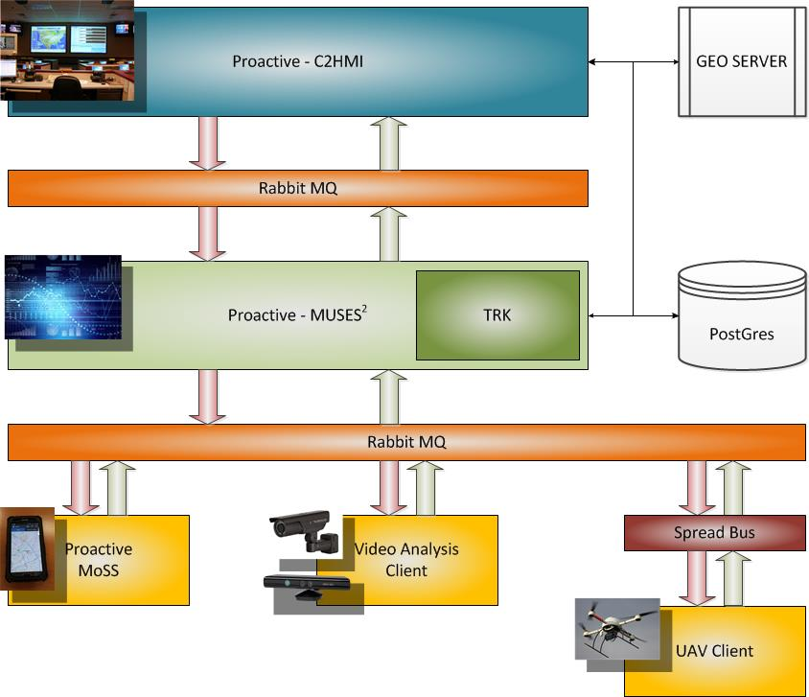
Romanian Police - Romania
Spanish Police - Spain
UAS Norway – Norway
The main objective of the workshop was to asses the performance of PROACTIVE prototypes and ensure that all requirements posed by the PROACTIVE end-user experts are met.
PROACTIVE partners are currently working on the integration of proactive solutions and demos for the final demonstration .
The demonstration architecture depicted in Figure ‎is defined by the following modules:
The PROACTIVE-C2HMI module, which handles the presentation of the data coming from the sensor fusion engine and the geographical information service (GIS). The data from the sensor fusion engine is fed into this module through the use of a RabbitMQ communication bus.
The PROACTIVE-MUSES^2 module, which provides the PROACTIVE system with the data fusion capabilities it needs. It integrates the Terrorist Reasoning Kernel, thus enabling online and offline potential threat detection.
The PROACTIVE-MoSS, which provides the PROACTIVE system with the events and the telemetry data coming from the field (Instrumented Policemen).
The Video Analysis Client, which analyses the video feeds coming from field cameras and the UAV video feed in order to extract high level events to be fed into the data fusion engine through the RabbitMQ bus.
The UAV Client, which handles the telemetry and live image feed coming from the UAV. The telemetry data is dispatched to the data fusion engine through the RabbitMQ bus.
The PROACTIVE demonstration scenario is based on the identification and prediction of two terrorist actions against a governmental building and in an open EXPO location. However, as the scenarios and the timescale extended over several weeks it cannot be faithfully set-up, demonstrated and validated as a whole in the final demonstration of the project, since the actual demonstration was time and space constrained. Therefore, only specific parts of the scenario would be demonstrated under real-time conditions including actors and real network and sensor components. To this end, a number of events associated with the scenario and specific PROACTIVE capabilities were defined and assigned for execution to PROACTIVE technical partners.
Project Facts:
PROACTIVE – Predictive reasOning and multi-source fusion empowering AntiCipation of attacks and Terrorist
actions In Urban EnVironmEnts
Contract Number: 285320
Duration: May 2012 - April 2015
Total Manpower (mm) : 532.5
Project Coordinator:
Mr Marco Cosentino
Vitrociset S.p.A., IT
Tel: +39 06 8820 4316
Fax: +39 06 8820 6189
Email: m.cosentino@vitrociset.it
More info at : http://www.fp7-proactive.eu

